Slide 1
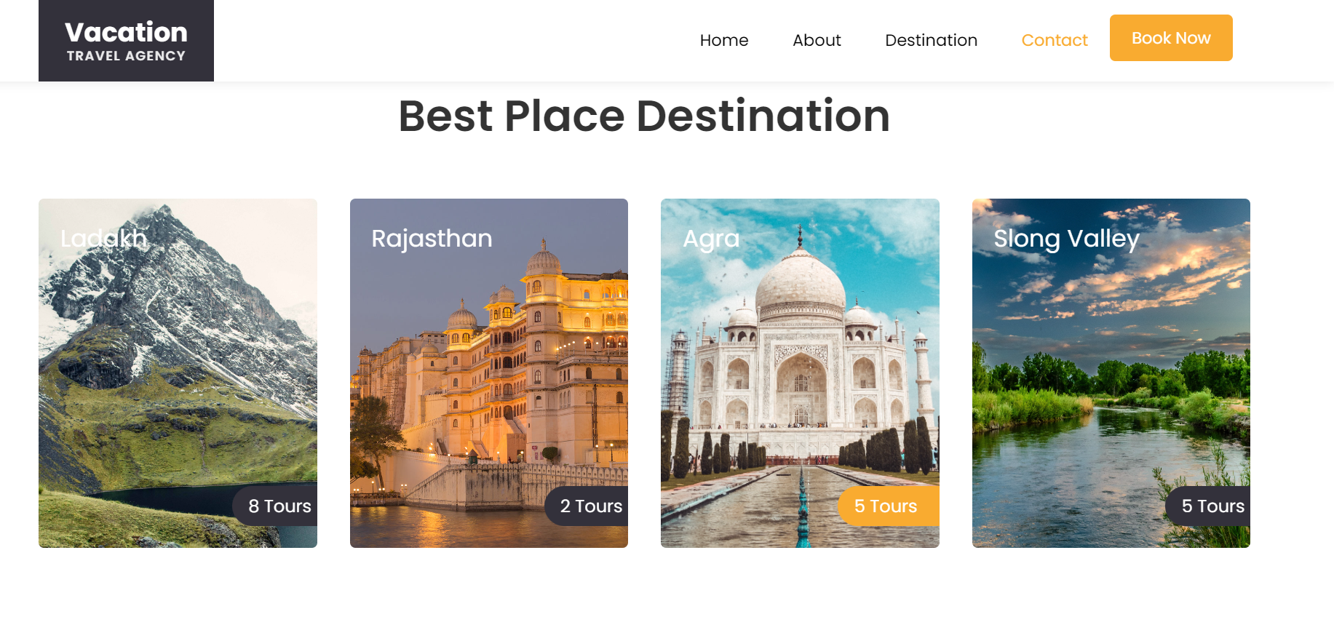
PRESENTATION ON “TOURS & TRAVELS”

Slide 2
MODULES OF PHP
Web Development:-
PHP
MY SQL
Web Designing:-
HTML
CSS
JAVASCRIPT
BOOTSTRAP

Slide 3
INTRODUCTION TO PHP
The term PHP is an acronym for PHP: Hypertext Preprocessor . PHP is a server-side scripting language designed specifically for web development.
One of the main reasons behind this is that PHP can be easily embedded in HTML files and HTML codes can also be written in a PHP file.
It runs on various platforms (Windows, Linux, Unix, Mac OS X, etc.) and is compatible with almost all servers used today (Apache, IIS, etc.)
Companies prefer PHP as it creates more efficient and dynamic web solutions. A website is an ultimate doorway for any organization that is in the IT sector. This is why there is high demand for PHP developers.

Slide 4
WEB DEVLOPMENT
Web development is the work involved in developing a Website for the Internet (World Wide Web) or an Intranet (a private network).
Web development can range from developing a simple single static page of plain text to complex web applications, electronic bussinesses and social network services.
Among Web professionals, "Web development" usually refers to the main non-design aspects of building Web sites: writing markup and coding.
Compnents of Web Development:-
Php
My Sql

Slide 5
WEB DESIGNING
Web designing is the creation of websites and pages to reflect a company's brand and information and ensure a user-friendly experience.
Though creating a website requires additional skills and resources, such as software coding and developing, the design aspect often focuses on the user interface and experience.
Components of Web Designing:-
Html
Css
Javascript
Bootstrap

Slide 6
INTRODUCTION TO THE PROJECT
A. Title: Vacation Travel Agency Website
B. Platform(Development):PHP(Language),MYSQL(Database)
C. Platform(Designing):CSS,JAVASCRIPT,HTML,BOOTSTRAP
D. Server: XAMMP

Slide 7
About the Website:-
The name of my website is “VACATION TRAVEL AGENCY” that contains all the necessary pages of a decent website. It includes , a Home page, a Destination page, a
Contact page, a Booknow page and an About us page.
One more page is added in which a Detailed Description of a website is shown if you click on one in the store or home page.

Slide 8
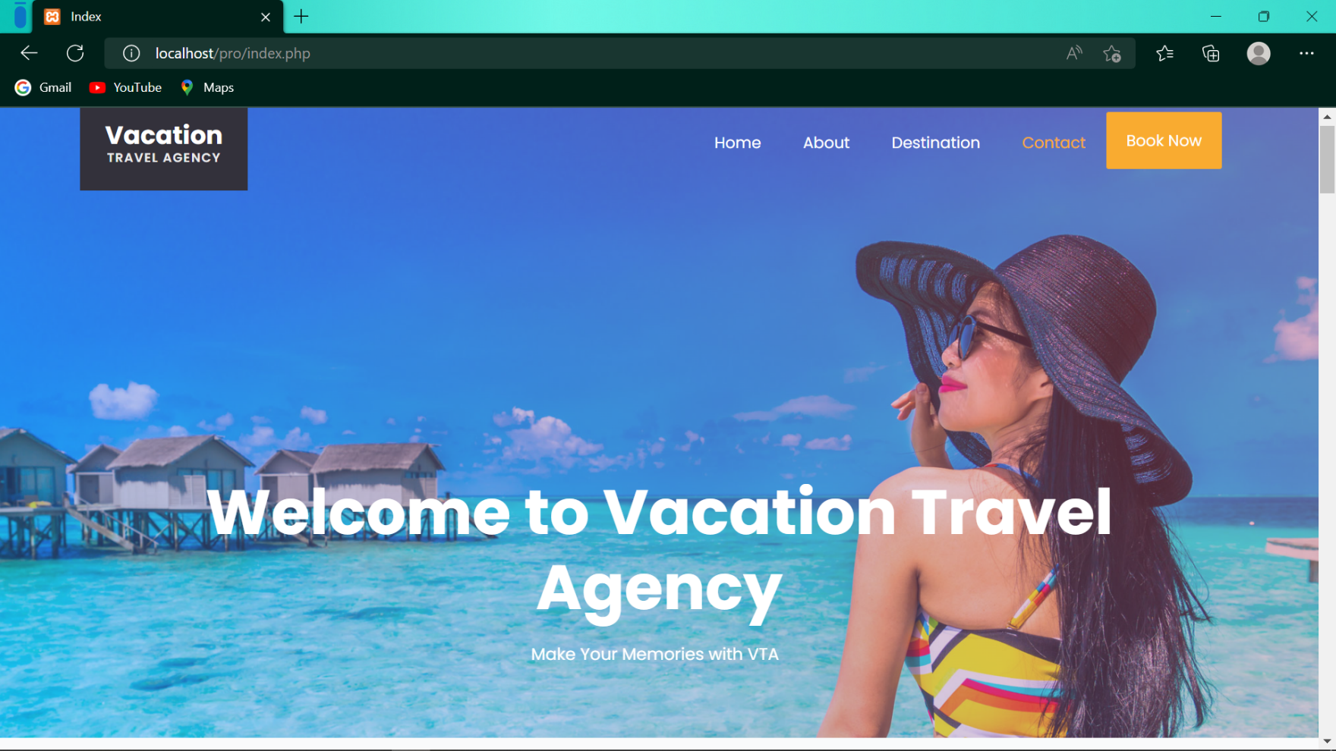
THE FIRST PAGE IS THE HOME PAGE

Slide 9
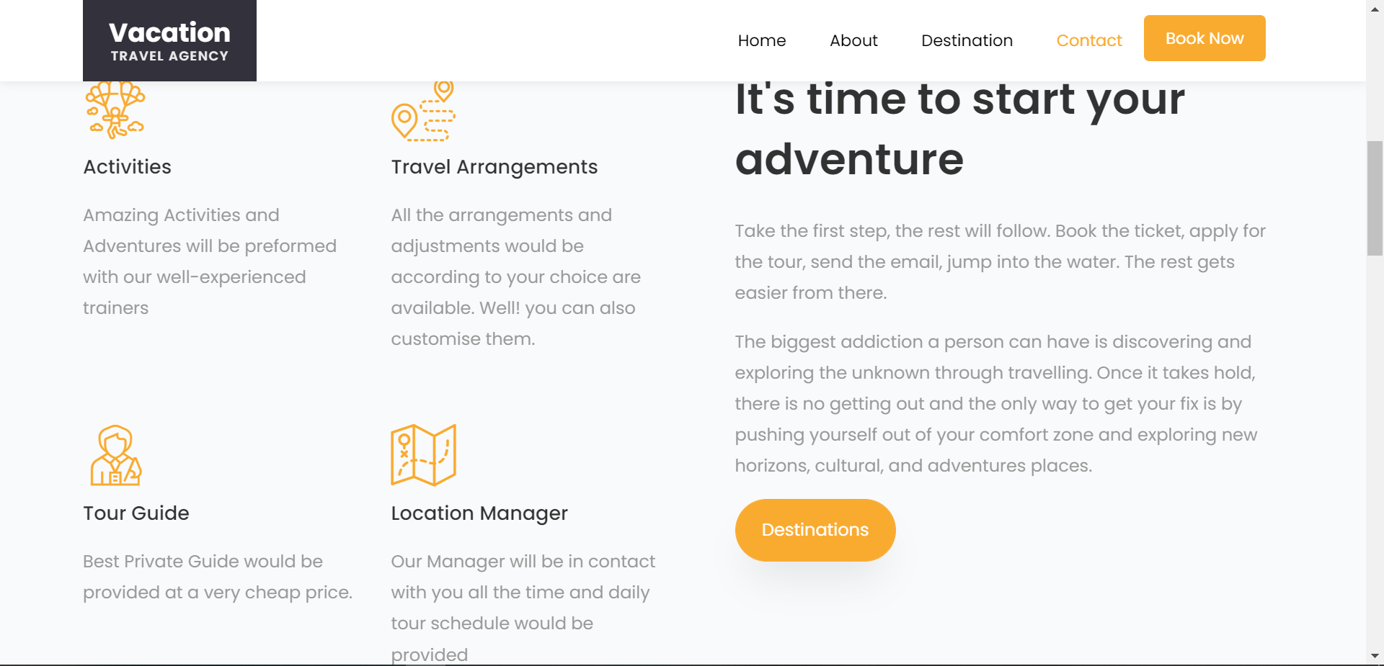
ABOUT US PAGE:-

Slide 10
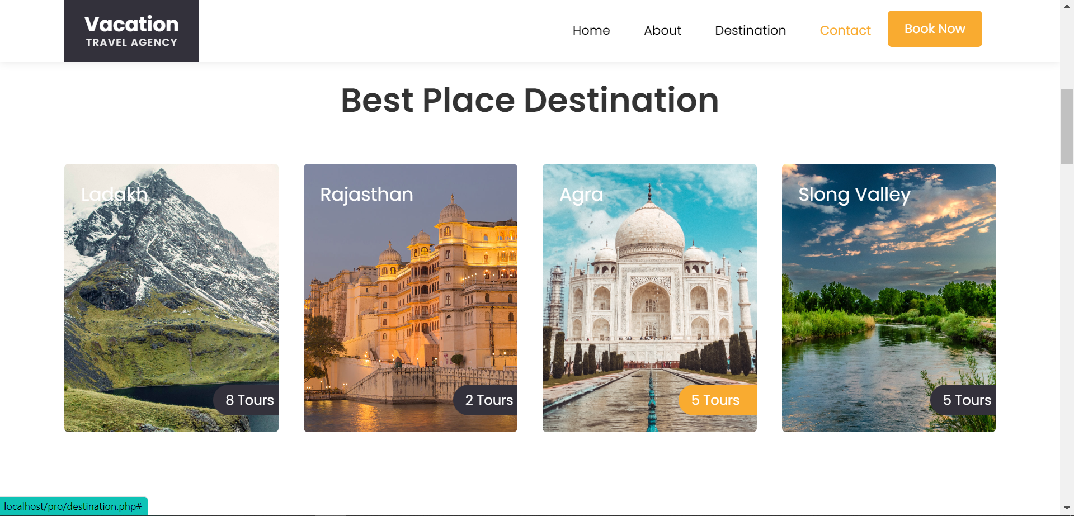
DESTINATIONS PAGE:-

Slide 11
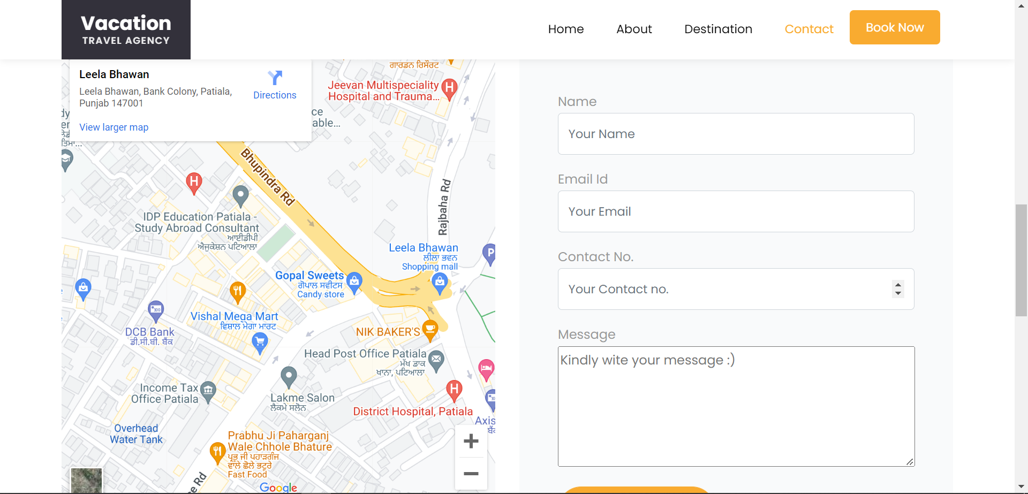
CONTACT US PAGE:-

Slide 12
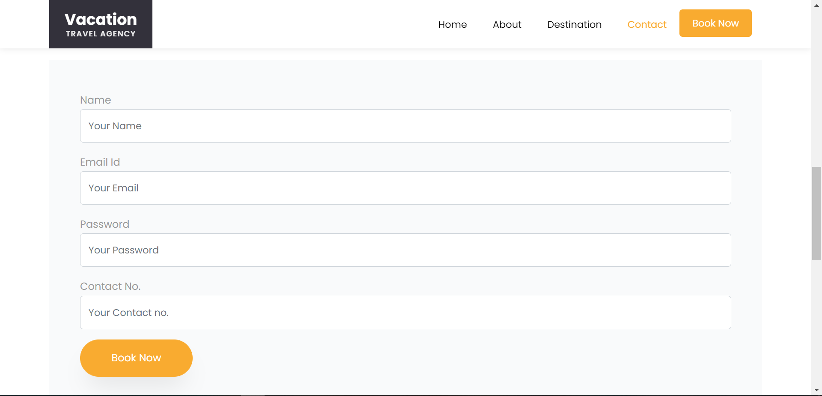
BOOKNOW PAGE:-

Slide 13
Thats all in my website, Hope you like it. Thank you
Name:Mahesh Vashisht
Roll no:12061008
Class:3CE56

